Slide 1
Case study 1:
Policy options and economic instruments for:
Improving watershed management and coastal protection

Slide 2
Threats to communities and ecosystems on Pacific islands (Hills et al. 2013)
GREEN INFRASTRUCTURE
helps to maintain
GREY INFRASTRUCTURE
Multiple benefits:
Water quality & quantity
Cost savings for water utility
Buffering floods & droughts
Wildlife
Potential ecotourism

Slide 3
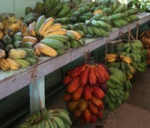
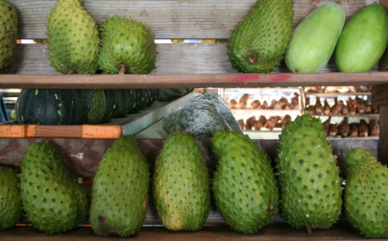
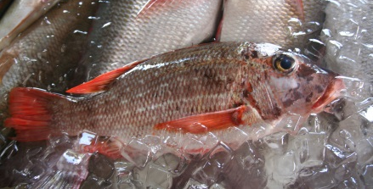
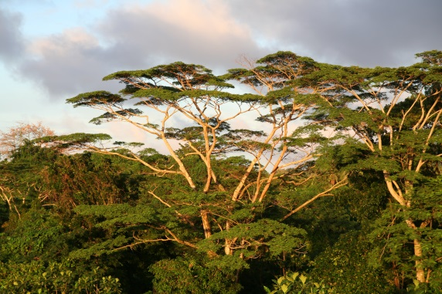
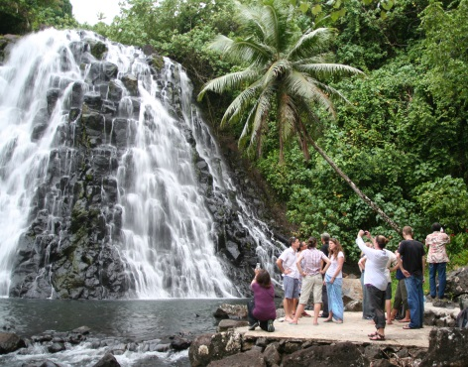
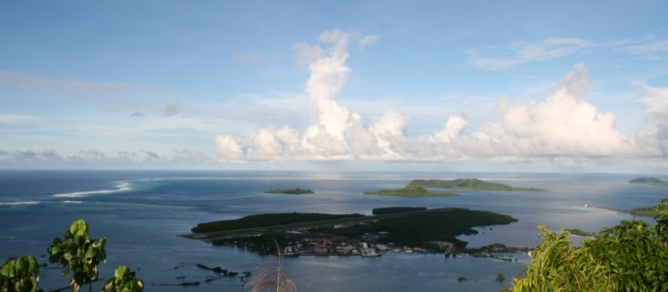
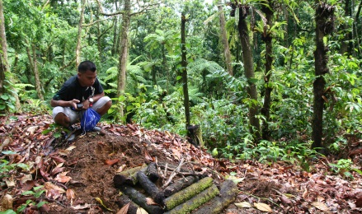
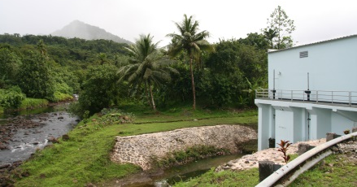
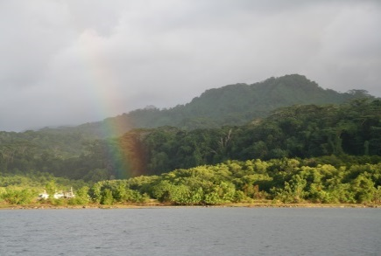

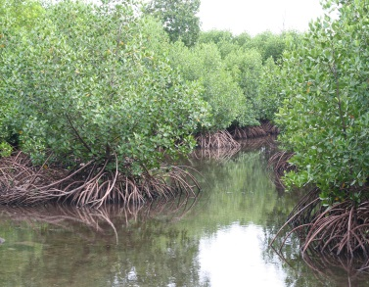
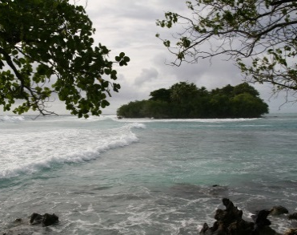

Ridge
to
Reef
upstream
downstream
coastline
reef
Carbon storage & Local climate regulation
Food provision
Recreation & Tourism
Erosion control
Water purification
Coastal protection
Water provision
Hydropower production
Moderation of extreme events
© Copyrights of all pictures: Johannes Förster, UFZ 2015 Location: Pohnpei, Caroline Islands, Federated States of Micronesia
© Copyrights of icons: Jan Sasse for TEEB

Slide 4
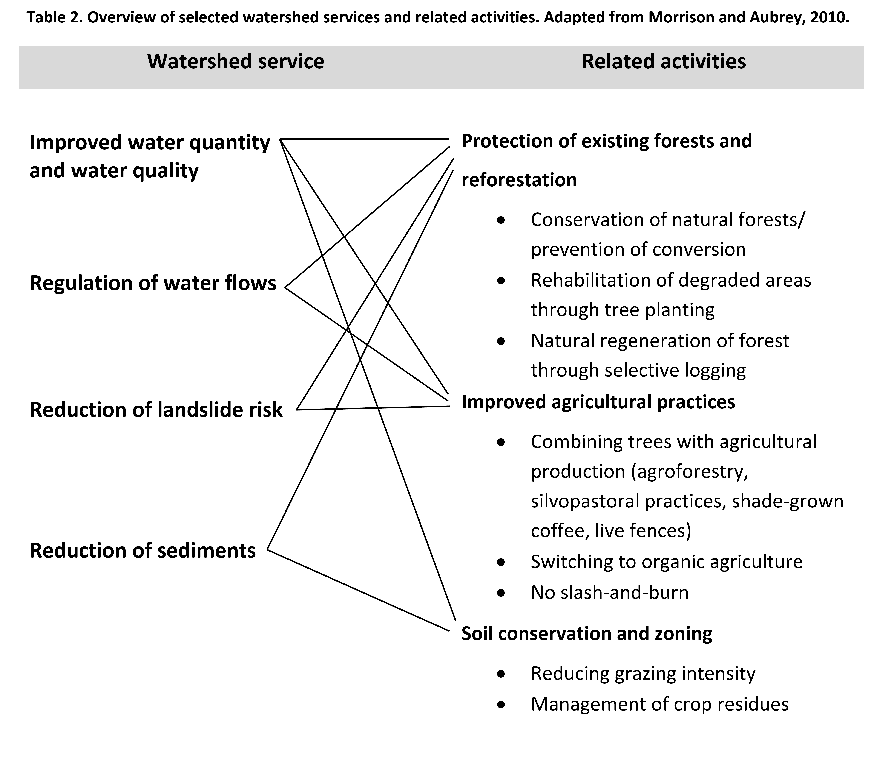
Figure 4: Overview of selected watershed services and related activities.
Source: Wienrich (2015) adapted from Morrison & Aubrey (2010).

Slide 5
Case study 2:
Policy options and economic instruments for:
Nature-based climate change mitigation in Germany

Slide 6
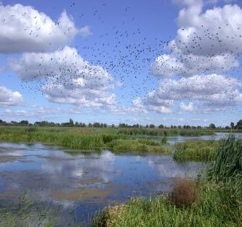
Nature-based climate change mitigation in Germany
Agriculture and mitigation of carbon emissions
drainage of 930,000 ha peatlands for agriculture caused emissions of 20 Mio. t of CO₂-eq. per year, @ social cost 1.4 billion €
Peatland restoration: low cost, biodiversity friendly mitigation
Mecklenburg-Vorpommern:
  Pilot project 2000-2008
  Restoration of 30,000 ha
  Reduced emissions up to 300,000 t CO₂-eq.
  cost of 8 to 12 € / t CO2 (& if land used for extensive grazing / reed production/ alder forest costs 0 to 4 € )
Restored peatland in Trebeltal 2007
Foto: D. Zak, http://www.fv-berlin.de
Source: Federal Environmental Agency 2007; MLUV MV 2009; Schäfer 2009
Notes:
(TEEBcase Peatland restoration for carbon sequestration, Germany)
References:
Couwenberg, J., Augustin, J., Michaelis, D., Wichtmann, W., Joosten, H., (2008) Entwicklung von Grundsätzen für die Bewertung von Niedermooren hinsichtlich ihrer Klimarelevanz. DUENE e.V., Greifwald.
Schäfer, A. (2009) Moore und Euros – die vergessenen Millionen. Archiv für Forstwesen und Landschaftsökologie 43, 156-160.
Schäfer, A. and H. Joosten (eds.) (2005) Erlenaufforstung auf wieder vernässten Niedermooren. DUENE e.V., Greifswald, 68p.
MLUV MV (2009) Konzept zum Schutz und zur Nutzung der Moore. Fortschreibung des Konzeptes zur Bestandssicherung und zur Entwicklung der Moore. Ministerium für Landwirtschaft, Umwelt und Verbraucherschutz Mecklenburg-Vorpommern, Schwerin, 109p.
Federal Environment Agency (2007) Economic Valuation of Environmental Damage. Methodological Convention for Estimates of Environmental Externalities. Dessau, 85p. URL: http://www.umweltdaten.de/publikationen/fpdf-l/3482.pdf (last access May 12, 2010)

Slide 7
Energy crops production (corn) on peatlands
Including climate costs
Including costs of N-deposition
1.000
Private benefit
€
86 €
86 €
86 €
other subsidies
500
333 €
333 €
333 €
Agriculture subsidies
185 €
185 €
185 €
Marginal return of crop
0
Damage cost
CO2-Emission
-500
Damage cost
N-Emission / deposition
1.200 €
1.200 €
Landscape beauty, regional climate effects,
Biodiversity loss
?
-1.000
305 €
-1.500
?
Schätzung für Niedermoor in Mecklenburg-Vorpommern: Ø-Werte €/ha/Jahr

Slide 8
Case study 3:
Policy options and economic instruments for:
Reducing emissions from Deforestation and forest Degradation (REDD+)

Slide 9
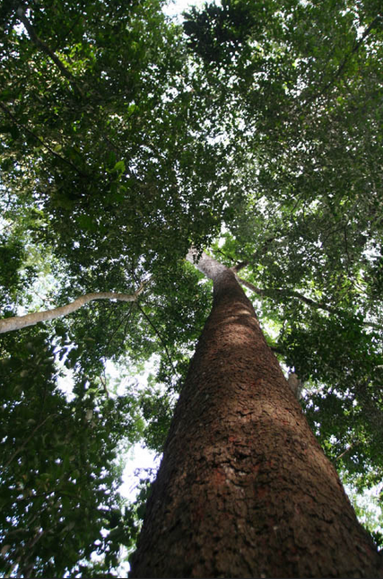
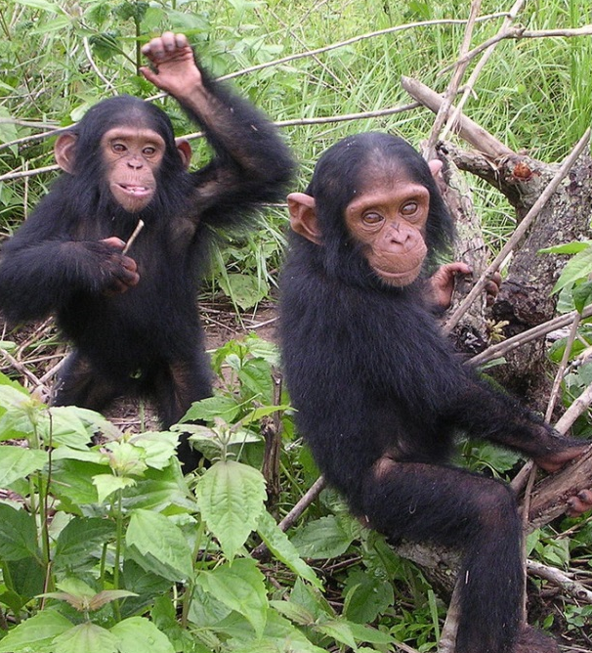
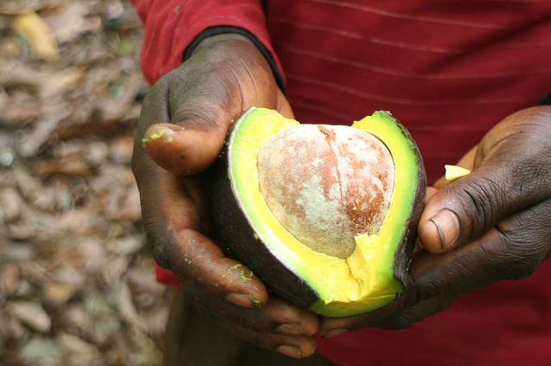
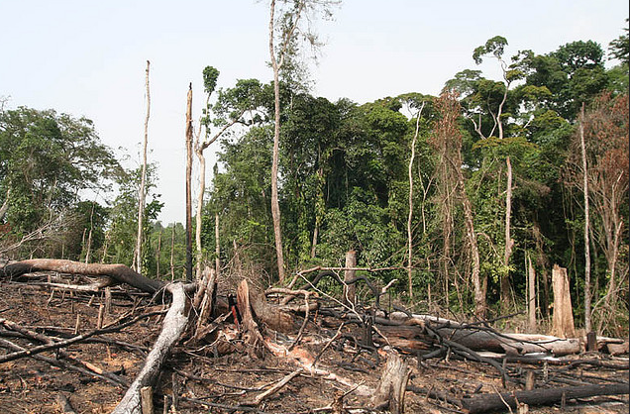
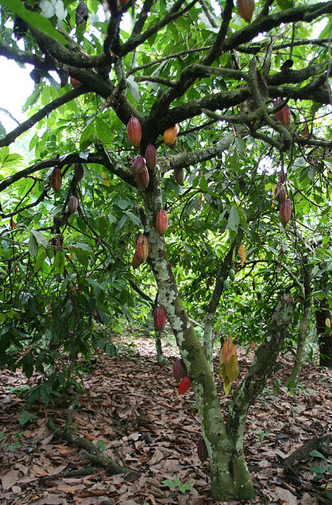
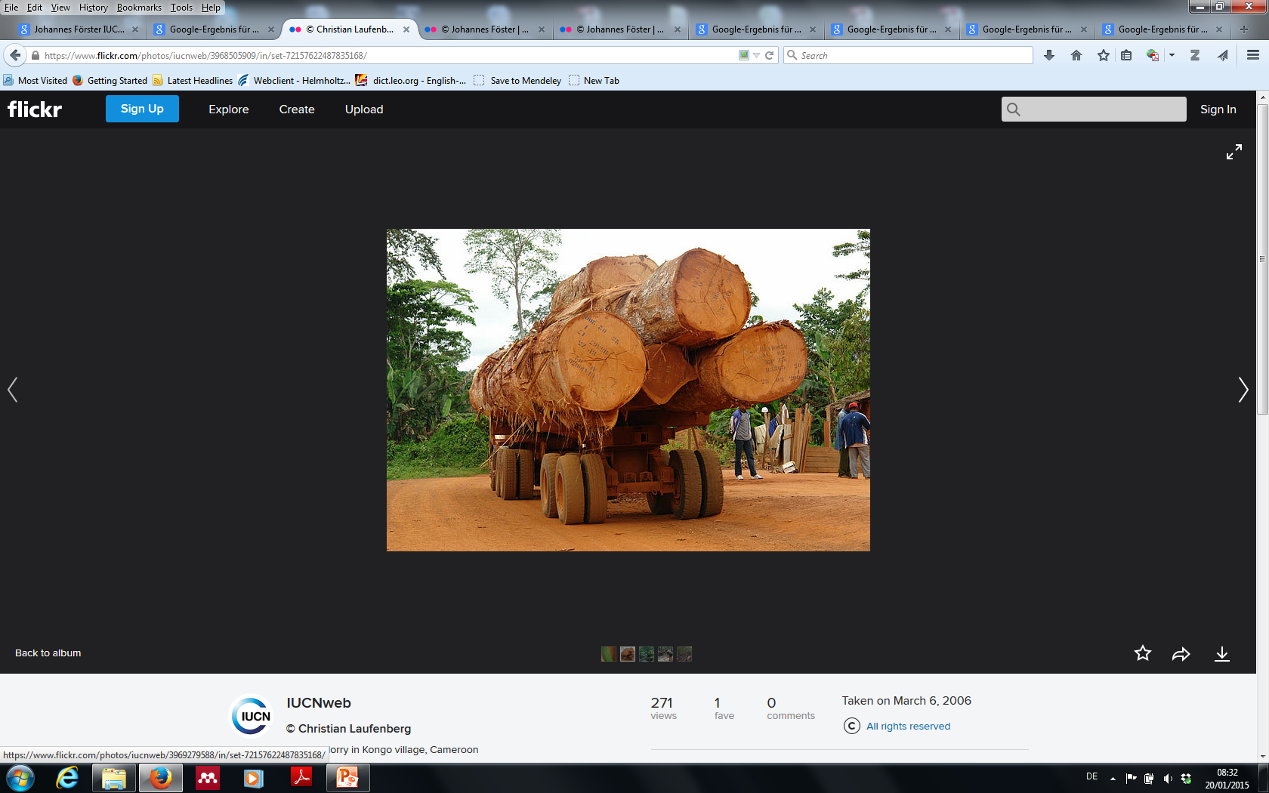
© Johannes Förster IUCNweb
© Delphine Bruyere
© Johannes Förster IUCNweb
© Christian Laufenberg IUCNweb
© Johannes Förster IUCNweb
© Johannes Förster IUCNweb

Slide 10
Deforestation
12% of global greenhouse gas emissions (van der Werf et al. 2009)
Reducing Emissions from Deforestation and Degradation (REDD+)
Mechanism under UNFCCC
Avoided carbon emissions can be used as offsets (voluntary carbon market)
Critique:
Critique, e.g. Corbera 2012:
isolating and commodifying the forest function of carbon sequestration
itemizing nature, overlooking inter-connectedness of ecosystem functions
replacing intrinsic motivation for forest conservation (e.g. spiritual and cultural values) by commercially driven interests

Slide 11
REDD+ Safeguards defined by UNFCCC:
REDD+ projects should:
“take into account the multiple functions of forests and other ecosystems”,
allow for “full and effective participation of relevant stakeholders, in particular indigenous peoples and local communities”, “
incentivize the protection and conservation of natural forests and their ecosystem services”,
and “enhance other social and environmental benefits”
(UNFCCC/CP/2010/7/Add.1, Appendix 1)

Slide 12
Case study 4:
Policy options and economic instruments for:
Tiger conservation in India

Slide 13
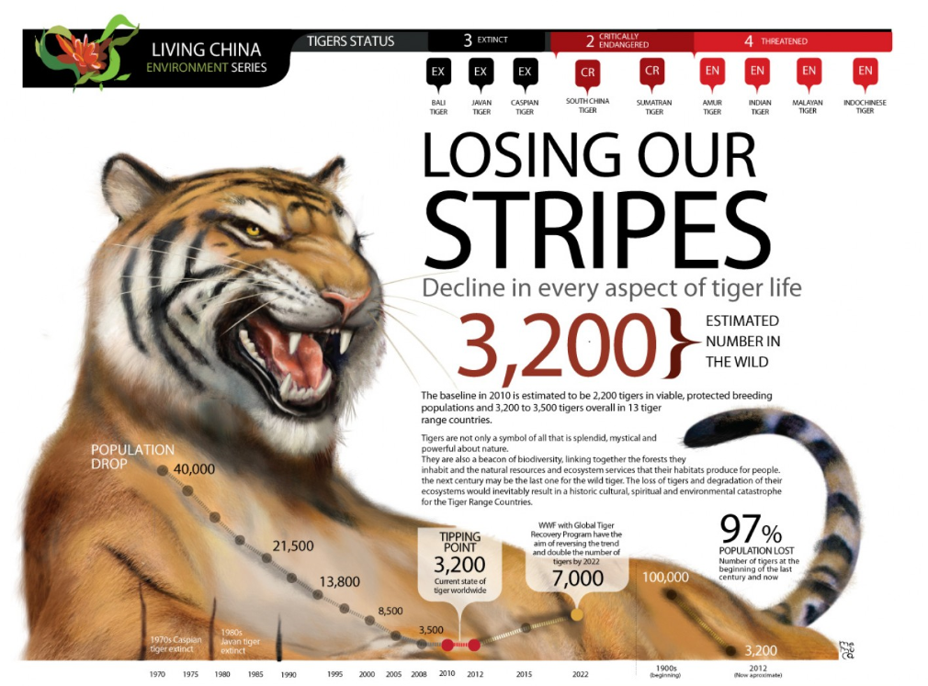

Slide 14
Problem: Tigers face unrelenting pressures poaching, retaliatory killings and habitat loss. They are forced to compete for space with dense and often growing human populations.
Tigers are a keystone species, directly ensures a stable ecosystem, indirectly has impacted tourism, livelihood and status of women and protect overall forest biome.
Benefits of conservation are reaped by local communities, indigenous tribes, India’s commitment to CBD and other MEAs, CITES.
Existing conservation efforts: Wildlife conservation law. Management: JFM and NGO lead regional projects, WWF a major contributor and the Global Tiger Initiative.
Options for improvement: efforts by NGOs being made in the right direction, but too slow. Policy and laws do not work to produce desired effect. Redirection of tourism revenue is not done. Lack of transparency. The attitude of urban dwellers towards the government we vote into power. Ask tough questions about the party’s environmental policy and outlook.

